Slide 1
Process Management Process Scheduling
Lecture 3 (Live Version)

Slide 2
Overview
Concurrent Execution
Process Scheduling
Definition
Process behavior
Processing environment
Criteria for good scheduling
Procedure of process scheduling
Scheduling Algorithms
For Batch Processing System
For interactive System

Slide 3
Concurrent Execution
Concurrent processes:
Logical concept to cover multitasked processes
Could be virtual parallelism
Could be physical parallelism
You can assume the two forms of parallelisms are not distinguished in the following discussion

Slide 4

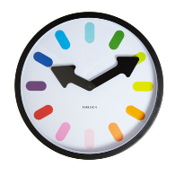
Concurrency Example (Simplistic)
Timeslicing
Process
A
a1 a2
a3
a4 a5 a6
b1 b2 b3
b4 b5
B
Time
t1
t2
t3
Notes:
Mention OS here

Slide 5
Interleaved Execution (context switch)
Context Switch
Process
A
a1 a2
a3
a4 a5 a6
b1 b2 b3
b4 b5
B
OS
Time
t1
t2
t3
Notes:
Tux pic

Slide 6
Multitasking OS
1 CPU: timesliced execution of tasks
p1
p2
p3
CPU
Multiprocessor: timeslicing on n CPUs
CPU 1
p1
p3
CPU 2
p2
p4

Slide 7
Scheduling in OS: A definition
Problems with having multiple processes:
If [ready-to-run processes] > [CPUs], which should be chosen?
Similar idea in thread-level scheduling
Known as the scheduling problem
Terminology:
Scheduler
Part of the OS that makes scheduling decision
Scheduling algorithm
The algorithm used by scheduler

Slide 8
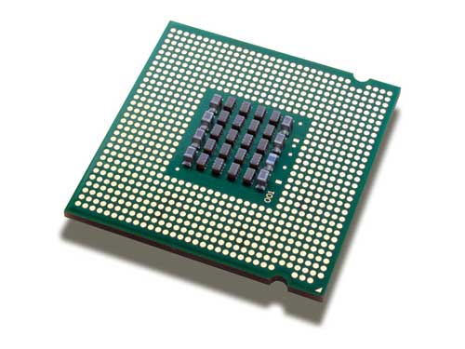
Scheduling: Illustration
selects process
Scheduler
allocates cpu
Processes ready to run
Each process has different requirement of CPU time
Process behavior
Multiple ways to allocate
Influenced by the process environment
Known as scheduling algorithms
A number of criteria to evaluate the scheduler

Slide 9
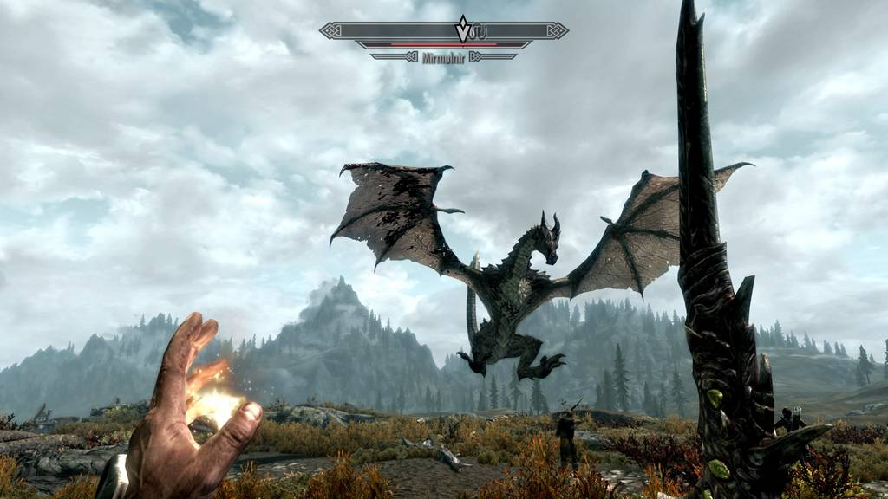
Process Behavior
A typical process goes through phases of:
CPU-Activity:
Computation
E.g. Number crunching
Compute-Bound Process spend majority of its time here
IO-Activity:
Requesting and receiving sercive from I/O devices
E.g. Print to screen, read from file etc
IO-Bound Process spend majority of its time here

Slide 10
3 Types of Processing Environment
Batch Processing:
No user: No interaction required, No need to be responsive
Interactive (or Multiprogramming):
With active user interacting with system
Should be responsive, consistent in response time
Real time processing:
Have deadline to meet
Usually periodic process

Slide 11
Criteria for Scheduling Algorithms
Many criteria to evaluate an scheduling algorithm
Criteria for all processing environments:
Fairness:
Should get a fair share of CPU time
per process basis OR
per user basis
Also mean no starvation
Balance:
All parts of the computing system should be utilized

Slide 12
When to perform scheduling?
Two types of scheduling policies
Non-preemptive (Cooperative)
A process stayed scheduled until:
it blocks OR
give up the CPU voluntarily
Preemptive
A process is given a fixed time quota to run
Possible to block or give up early
At the end of the time quota:
Another process get picked if available

Slide 13
Scheduling a Process: Step-by-Step
1
2
3
4
5
If Context switch is needed:
Pick a suitable process P to run base on scheduling algorithm
Setup the context for P
Let process P run
Scheduler is triggered ( OS takes over )
Context of current running process is saved and placed on blocked queue / ready queue

Slide 14
Scheduling for Batch Processing

Slide 15
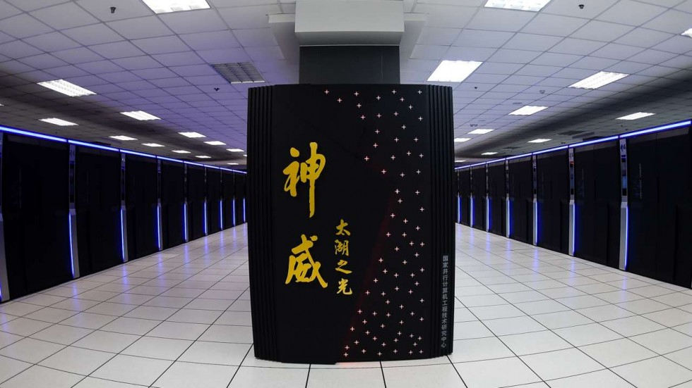
Overview – Batch Processing
On batch processing system:
No user interaction
Non-preemptive scheduling is predominant
Scheduling algorithms are generally easier to understand and implement
Variant/Improvement are used for scheduling other type of systems
Three algorithms covered:
First-Come First Served (FCFS)
Shortest Job First (SJF)
Shortest Remaining Time Next (SRT)
Sunway TaihuLight
93 petaflops

Slide 16
Criteria for batch processing
Turnaround time:
Total time taken, i.e. [finish - start time]
Related to waiting time: time spent waiting for CPU
Throughput:
Number of tasks finished per unit time
CPU utilization:
Percentage of time when CPU is working on a task

Slide 17
First-Come First-Served: FCFS
General Idea:
Guaranteed to have no starvation:
The number of tasks in front of task X in FIFO is always decreasing
➔ task X will get its chance eventually

Slide 18
First-Come First-Served: Illustration
Tasks Queue
A: 8 TUs
B: 5 TUs
C: 3 TUs
C: 3 TUs
B: 5 TUs
C: 3 TUs
Notes:
Talk about alternative drawing (time chart)
Talk about waiting time, turnaround time.

Slide 19
First-Come First-Served: Shortcomings
Simple reordering can reduce the average waiting time!
Convoy Effect:
First task (task A) is CPU-Bound and followed by a number IO-Bound tasks X
Tasks A running
All tasks X waiting in ready queue (I/O device idling)
Tasks A blocked on I/O
All tasks X execute quickly and blocked on I/O (CPU idling)
Notes:
Talk about implementation

Slide 20
Shortest Job First: SJF
General Idea:
Select task with the smallest total CPU time
Notes:
Need to know total CPU time for a task in advance
Given a fixed set of tasks:
Minimizes average waiting time

Slide 21
Shortest Job First: Illustration
Tasks Queue
A: 8 TUs
B: 5 TUs
C: 3 TUs
Notes:
Mention Task "Queue" is not really a Queue
Mention Starvation

Slide 22
Shortest Job First: Predicting CPU Time
Guess the future CPU time by the previous CPU-Bound phases
Common approach (Exponential Average):
Predicted_{n+1} = αActual_{n}+(1-α)Predicted_{n}
Actual_{n} = The most recent CPU time consumed
Predicted_{n} = The past history of CPU Time consumed
α = Weight placed on recent event or past history
Predicted_{n+1} = Latest prediction

Slide 23
Shortest Remaining Time: SRT
General Idea:
Variation of SJF:
Use remaining time
Preemptive
Select job with shortest remaining (or expected) time
Notes:
New job with shorter remaining time can preempt currently running job
Provide good service for short job even when it arrives late

Slide 24
Shortest Remaining Time First: Illustration
Tasks
Arrival Time
A: 8 TUs
Time 0
C: 3 TUs
Time 1
B: 5 TUs
Time 2

Slide 25
Scheduling for Interactive Systems

Slide 26
Criteria for interactive environment
Response time:
Time between request and response by system
Predictability:
Variation in response time, lesser variation == more predictable
Preemptive scheduling algorithms are used to ensure good response time
➔ Scheduler needs to run periodically

Slide 27
Ensuring Periodic Scheduler
Questions:
How can the scheduler "take over" the CPU periodically?
How can we ensure the user program can never stop the scheduler from executing?
Ingredients for answer:
Timer interrupt = Interrupt that goes off periodically (based on hardware clock)
OS ensure timer interrupt cannot be intercepted by any other program
➔ Timer interrupt handler invokes scheduler

Slide 28
Terminology: Timer & Time Quantum
Interval of Timer Interrupt:
OS scheduler is triggered every timer interrupt
Typical values (1ms to 10ms )
Time Quantum:
Execution duration given to a process
Could be constant or variable among the processes
Must be multiples of interval of timer interrupt
Large range of values (commonly 5ms to 100ms)

Slide 29
Illustration: ITI vs Time Quantum
Interval of Timer Interrupt = 10ms
Time Quantum = 20ms
Interval of Timer Interrupt = 10ms
Time Quantum = 40ms

Slide 30
Scheduling Algorithms:
Algorithms covered:
Round Robin (RR)
Priority Based
Multi-Level Feedback Queue (MLFQ)
Lottery Scheduling

Slide 31
Round Robin: RR
General Idea:
Tasks are stored in a FIFO queue
Pick the first task from queue front to run until:
A fixed time slice (quantum) elapsed
The task gives up the CPU voluntarily
The task blocks
The task is then placed at the end of queue to wait for another turn
Blocked task will be moved to other queue to wait for its request
When blocked task is ready again, it is placed at the end of queue

Slide 32
Round Robin: RR (cont)
Notes:
Basically a preemptive version of FCFS
Response time guarantee:
Given n tasks and quantum q
Time before a task get CPU is bounded by (n-1)q
Timer interrupt needed:
For scheduler to check on quantum expiry
The choice of time quantum duration is important:
Big quantum: Better CPU utilization but longer waiting time
Small quantum: Bigger overhead (worse CPU utilization) but shorter waiting time

Slide 33
Round Robin: Illustration
Execution Timeline
A: 2 TUs
A: 2 TUs
A: 1 TU
B: 2 TUs
B: 2 TUs
B: 2 TUs
C: 2 TUs
C: 1 TUs

Slide 34
Priority Scheduling
General Idea:
Some processes are more important than others
Cannot treat all process as equal
Assign a priority value to all tasks
Select task with highest priority value
Variants:
Preemptive version:
Higher priority process can preempts running process with lower priority
Non-preemptive version:
Late coming high priority process has to wait for next round of scheduling
All animals are equal but some animals are more equal than others.
George Orwell, "Animal Farm"

Slide 35
Priority Scheduling: Illustration
Tasks
Arrival Time
Priority (1=highest)
A: 8 TUs
Time 0
3
C: 3 TUs
Time 1
1
B: 5 TUs
Time 1
5

Slide 36
Priority Scheduling: Shortcomings
Low priority process can starve:
High priority process keep hogging the CPU
Worse in preemptive variant
Possible solutions:
Decrease the priority of currently running process after every time quantum
Give the current running process a time quantum
Hard to guarantee or control the exact amount of CPU time given to a process using priority

Slide 37
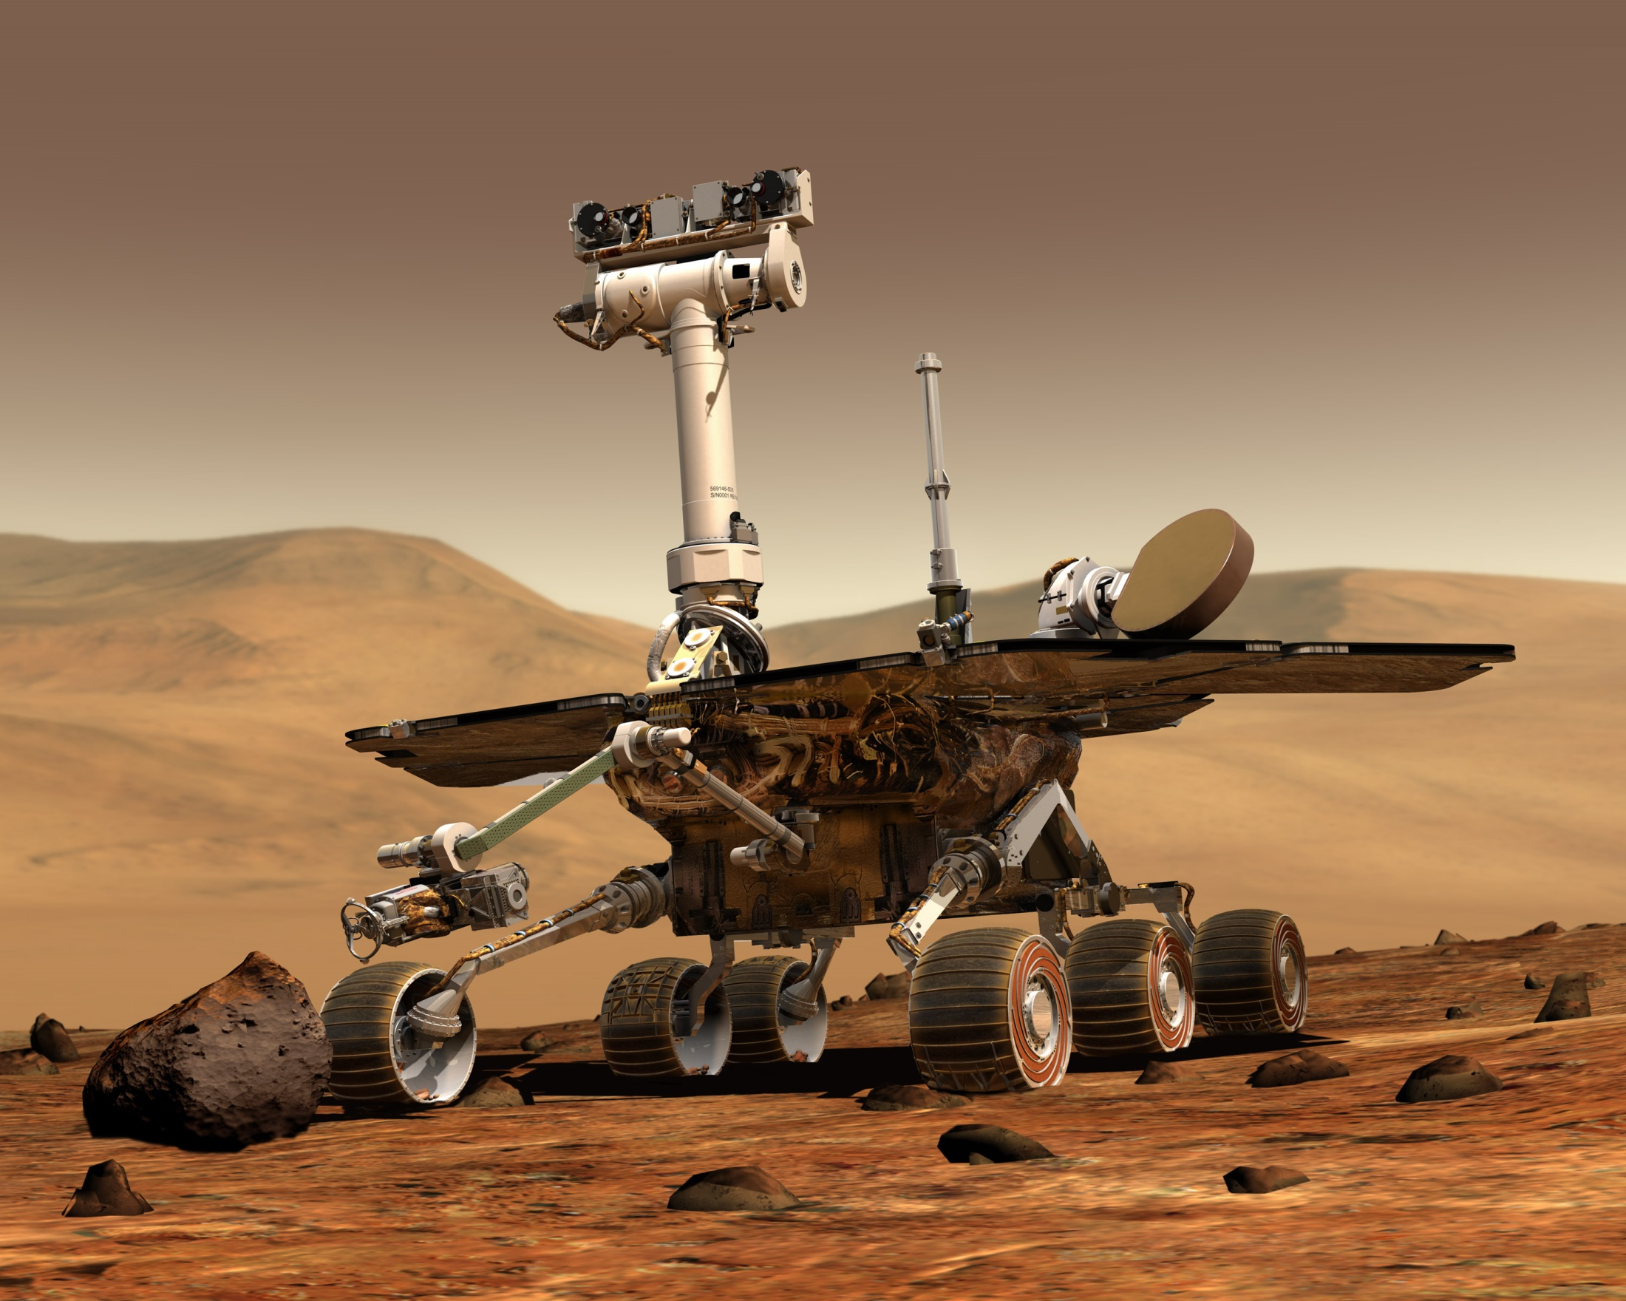
Priority Scheduling: Priority Inversion
Got rekted by Priority Inversion problem ☹
Consider the scenario:
Priority: {A = 1, B=3, C= 5} (1 is highest)
Task C starts and locks a resource (e.g. file)
Task B preempts C
C is unable to unlock the file
Task A arrives and need the same resource as C
but the resource is locked!
Task B continues executes even if Task A has higher priority
Known as Priority Inversion:
Lower priority task preempts higher priority task

Slide 38
Multi-level Feedback Queue (MLFQ)
Solve one BIG + HARD issue:
How do we schedule without perfect knowledge?
Most algorithms requires certain information (process behavior, running time, etc)
MLFQ is:
Adaptive:
"Learn the process behavior automatically"
Minimizes both:
Response time for IO bound processes
Turnaround time for CPU bound processes
Adapted from: Operating System – 3 easy pieces

Slide 39
MLFQ: Rules
Basic rules:
If Priority(A) > Priority(B) ➔ A runs
If Priority(A) == Priority(B) ➔ A and B runs in RR
Priority Setting/Changing rules:
New job ➔ Highest priority
If a job fully utilized its time slice ➔ priority reduced
If a job give up / blocks before it finishes the time slice ➔ priority retained

Slide 40
MLFQ: Example 1
3 Queues: Q2 (highest priority), Q1, Q0
A single long running job
Basic rules:
If Priority(A) > Priority(B) ➔ A runs
If Priority(A) == Priority(B) ➔ A and B runs in RR
Priority Setting/Changing rules:
New job ➔ Highest priority
If a job fully utilized its time slice ➔ priority reduced
If a job give up / blocks ➔ priority retained
Queues
Q2
Q1
Q0
Time

Slide 41
MLFQ: Example 2
Example 1 + a short job in the middle
Basic rules:
If Priority(A) > Priority(B) ➔ A runs
If Priority(A) == Priority(B) ➔ A and B runs in RR
Priority Setting/Changing rules:
New job ➔ Highest priority
If a job fully utilized its time slice ➔ priority reduced
If a job give up / blocks ➔ priority retained
Queues
Q2
Q1
Q0
Time

Slide 42
MLFQ: Example 3
Two jobs:
A = CPU bound (already in the system for quite some time)
B = I/O bound
Queues
Q2
Q1
Q0
Time

Slide 43
MLFQ: Questions to ponder
Can you think of a way to abuse the algorithm? ☺
Equivalent question: MLFQ does not work well for what kind combination of jobs?
What are the ways to rectify the above?
Basic rules:
If Priority(A) > Priority(B) ➔ A runs
If Priority(A) == Priority(B) ➔ A and B runs in RR
Priority Setting/Changing rules:
New job ➔ Highest priority
If a job fully utilized its time slice ➔ priority reduced
If a job give up / blocks ➔ priority retained

Slide 44
Lottery Scheduling
General Idea:
Give out “lottery tickets” to processes for various system resources
When a scheduling decision is needed:
A lottery ticket is chosen randomly among eligible tickets
The winner is granted the resource
In the long run, a process holding X% of tickets
Can win X% of the lottery held
Use the resource X% of the time

Slide 45
Lottery Scheduling: Properties
Responsive:
A newly created process can participate in the next lottery
Provides good level of control:
A process can be given Y lottery tickets
It can then distribute to its child process
An important process can be given more lottery tickets
Can control the proportion of usage
Each resource can have its own set of tickets
Different proportion of usage per resource per task

Slide 46
Summary
Scheduling in OS:
Basic definition
Factors that affect scheduling
Process, Environment
Criteria of good scheduling
Scheduling Algorithms:
FCFS, SJF, SRT for Batch Processing System
RR, Priority, Multi-Level Queues and Lottery scheduling for Interactive System

Slide 47
Reference
Modern Operating System (3rd Edition)
Chapter 2.4
Operating System Concepts (7th Edition)
Chapter 5
Operating Systems: Three Easy Pieces
By Arpaci-Dusseau and Arpaci-Dusseau
http://pages.cs.wisc.edu/~remzi/OSTEP/

Slide 48
When to perform scheduling?
Non-preemptive (Cooperative)
A process stayed scheduled (in running state) until it blocks or give up the CPU voluntarily
Preemptive
A process is given a fixed time quota to run
possible to block or give up early
At the end of the time quota, the running process is suspended
Another process get picked if available
E

Slide 49
Generic 5-State Process Model
Terminated
New
admit
switch: scheduled
exit
create
Ready
Running
switch: release
CPU
event wait
event occurs
Blocked
E

Slide 50

Concurrency Example (Simplistic) QQ
4
Notes:
Mention OS here

Slide 51
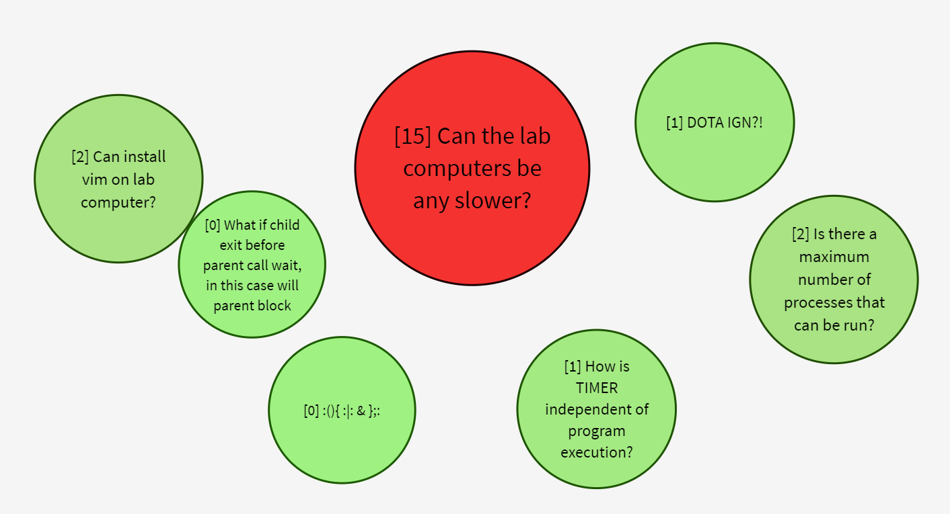
Still Burning…..
E

